Slide 1
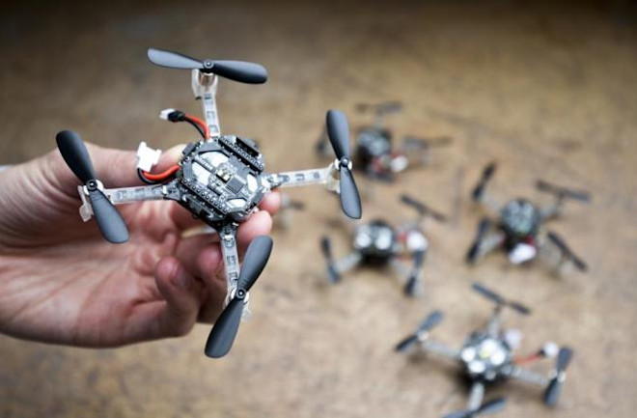
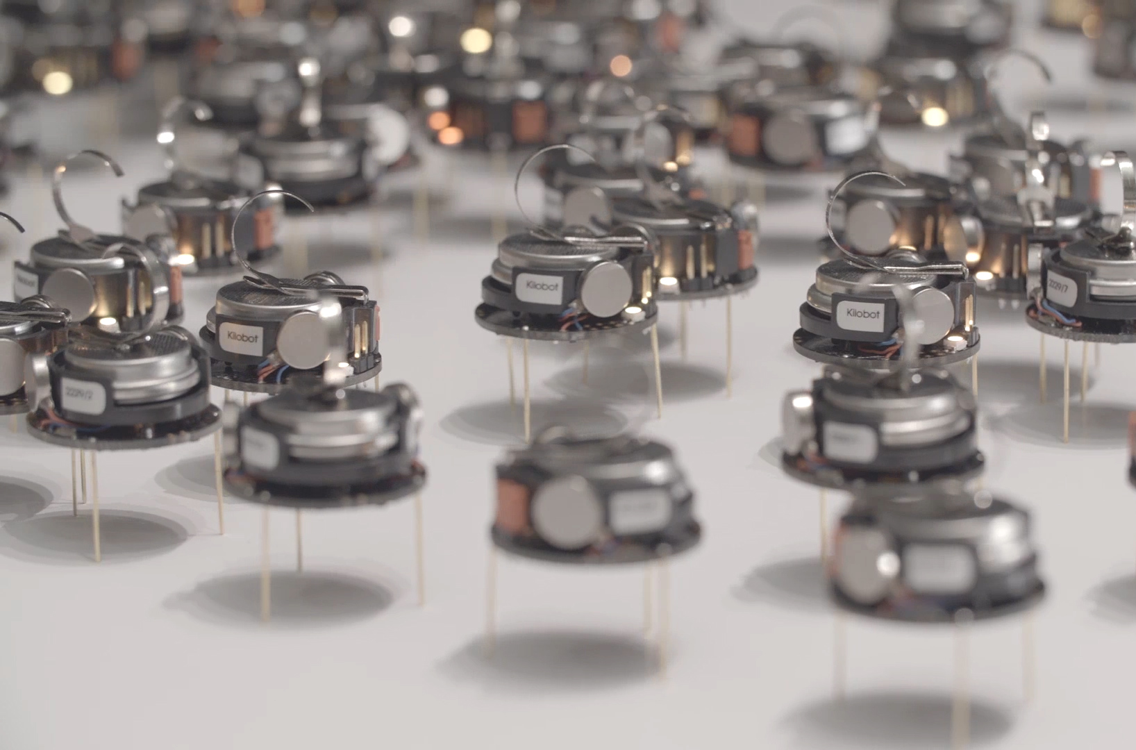
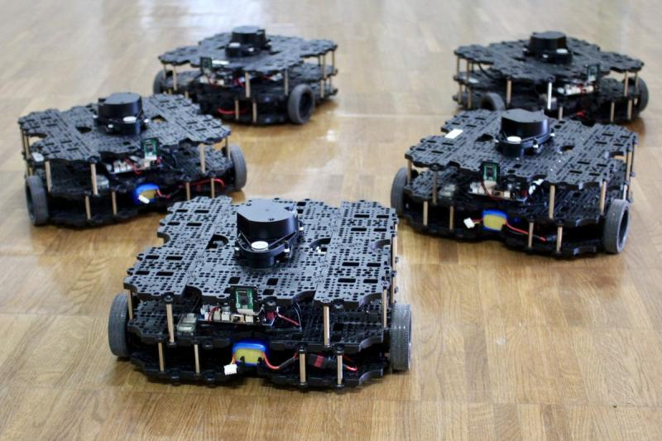

ECE693H, Spring 2025: Multi-robot System Design
“Perception 1”
Dr. Daniel Drew

Slide 2
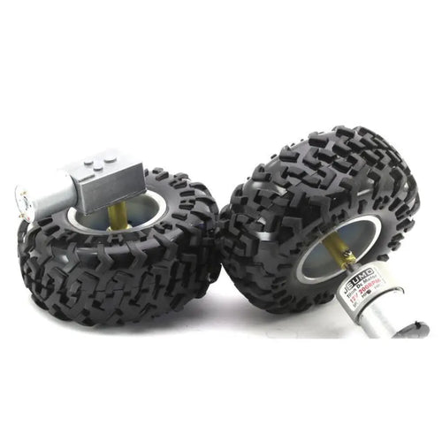
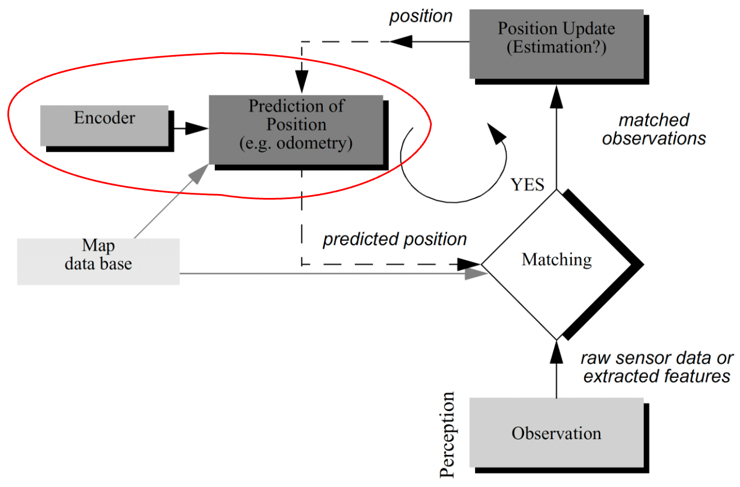
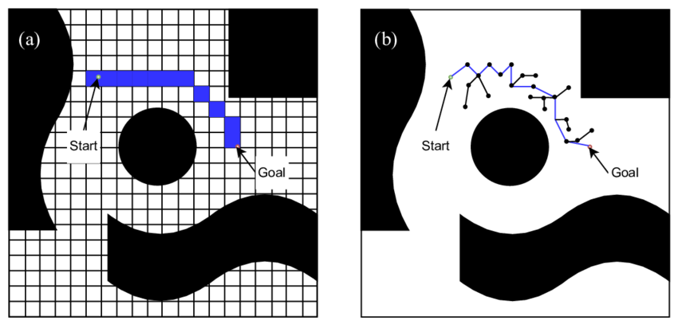
Action Recap
Localization / Odometry
Action
Ascending the stack from the motor
Path and Motion Planning
Electromagnetic motors
Motor gearing and mechanics
Motor driver electronics
Encoders

Slide 3
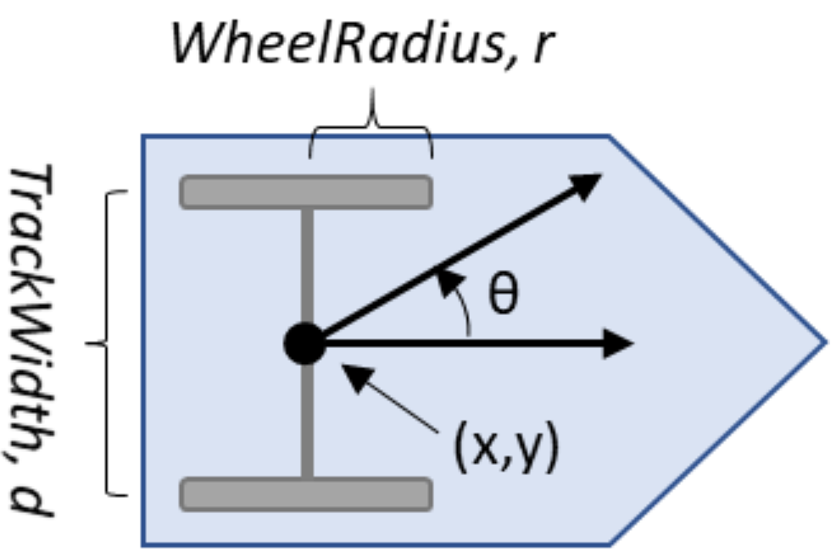
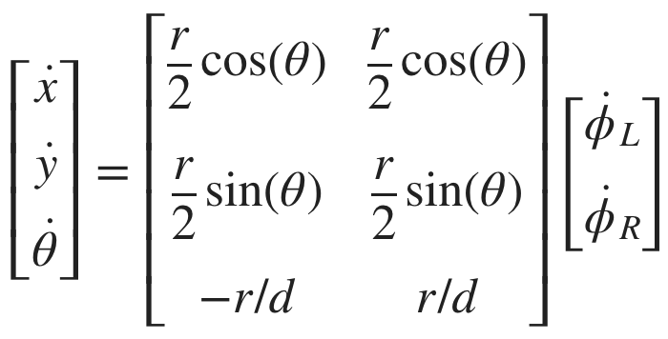
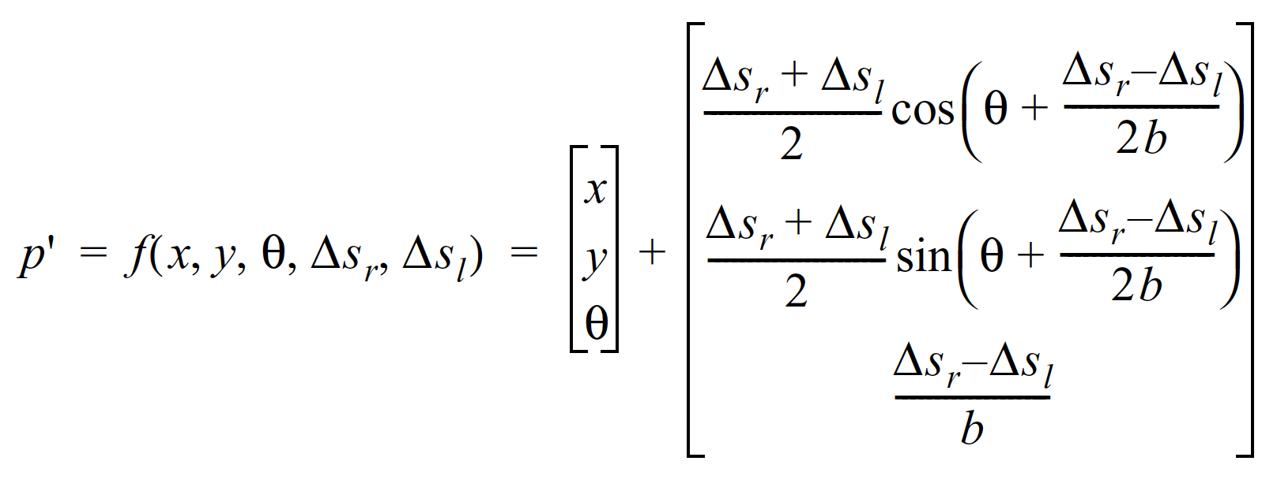
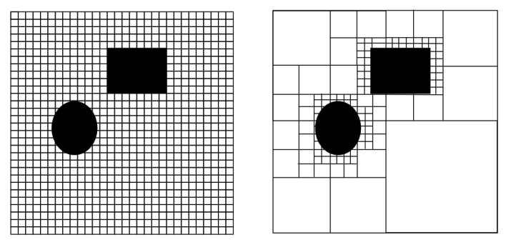
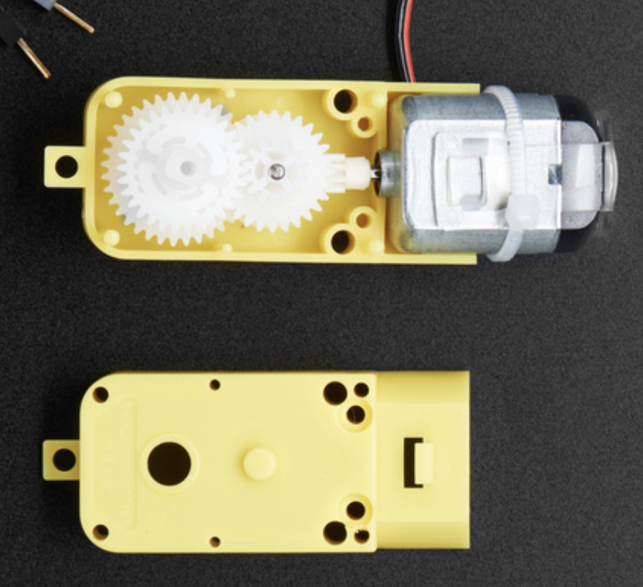
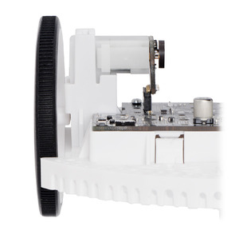
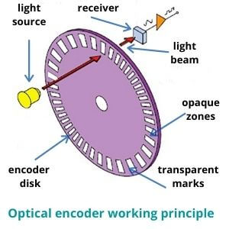
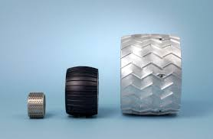
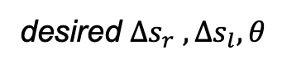
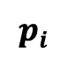
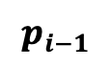

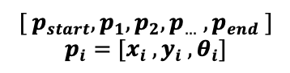
Action: End-to-End Overview
series of poses
$${[ p}_{start}, p_{1},p_{2},p_{…} , p_{end} ]$$
$$p_{i}=[x_{i} , y_{i} , θ_{i}]$$
$$p_{i−1}$$
Path Planning
$$p_{i}$$
Kinematics
desired $Δs_{r} , Δs_{l}, θ$
physical
parameters
$$Δs=\frac{Δenc}{CPR∗gr}∗c_{wheel}$$
Motor
Wheel
Encoder
Odometry

Slide 4
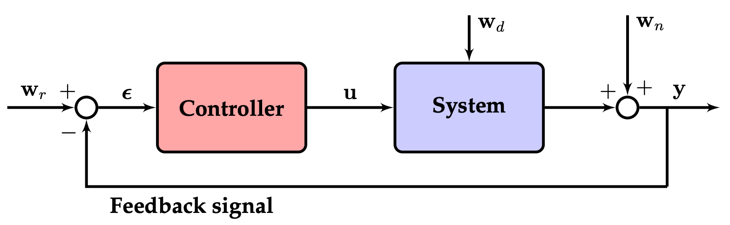
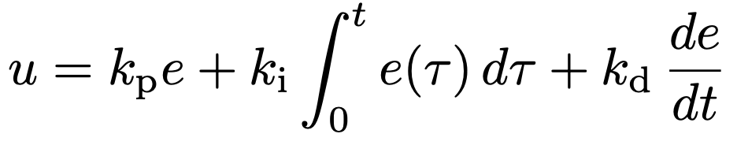

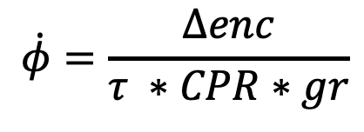
Action: End-to-End Overview
$$Δs=\frac{Δenc}{CPR∗gr}∗c_{wheel}$$
series of poses
$${[ p}_{start}, p_{1},p_{2},p_{…} , p_{end} ]$$
$$p_{i}=[x_{i} , y_{i} , θ_{i}]$$
Path Planning
Kinematics / Odometry
What about speed?
$$\dot{φ}=\frac{Δenc}{τ ∗CPR∗gr}$$
Easiest thing to do / assume: constant linear velocity

Slide 5
Questions?

Slide 6
Class Overview
Lecture (~45 minutes)
Subsystem check-in (~20 minutes)

Slide 7
Perception: Lecture 1 of 2
Lecture 1: sensors → data acquisition
Lecture 2: signal processing → mapping

Slide 8
Lecture Overview: Ascending the Stack
Overview / Taxonomy
Sensor physics
Readout electronics

Slide 9
Sensors: Types and Examples
CLASS
QUANTITY
NAME
LiDAR
Distance
Time-of-flight,
received angle/intensity
Active
Ultrasonic
Infrared
IMU
Intensity
Sound pressure
Image
Humidity
Altimeter /
Barometer
Passive
Microphone
Camera

Slide 10
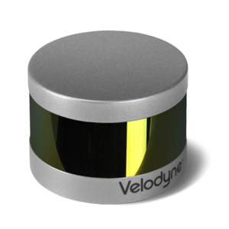
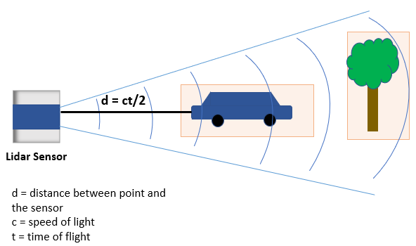
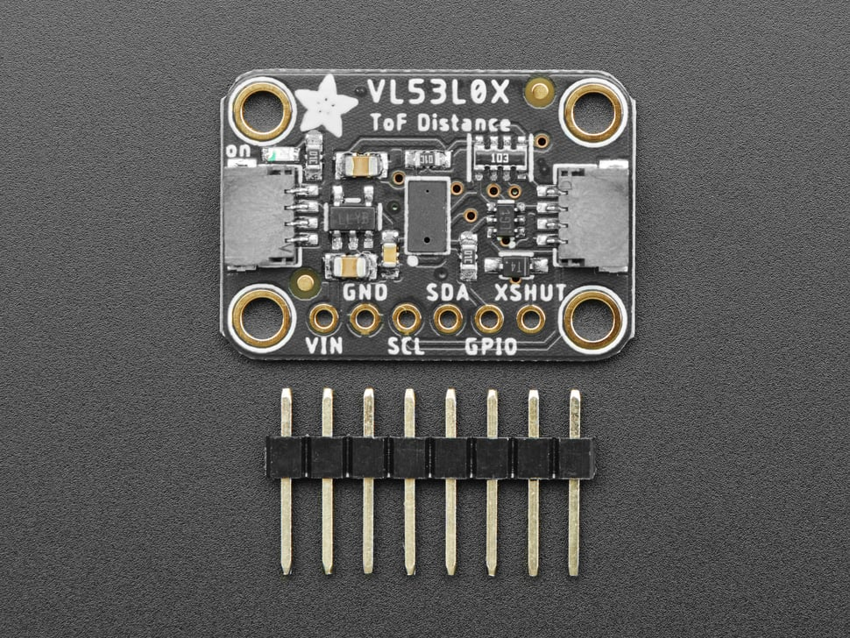
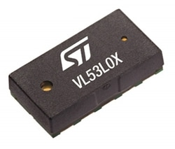
Sensors: Optical Time-of-Flight
Light Detection and Ranging

Slide 11
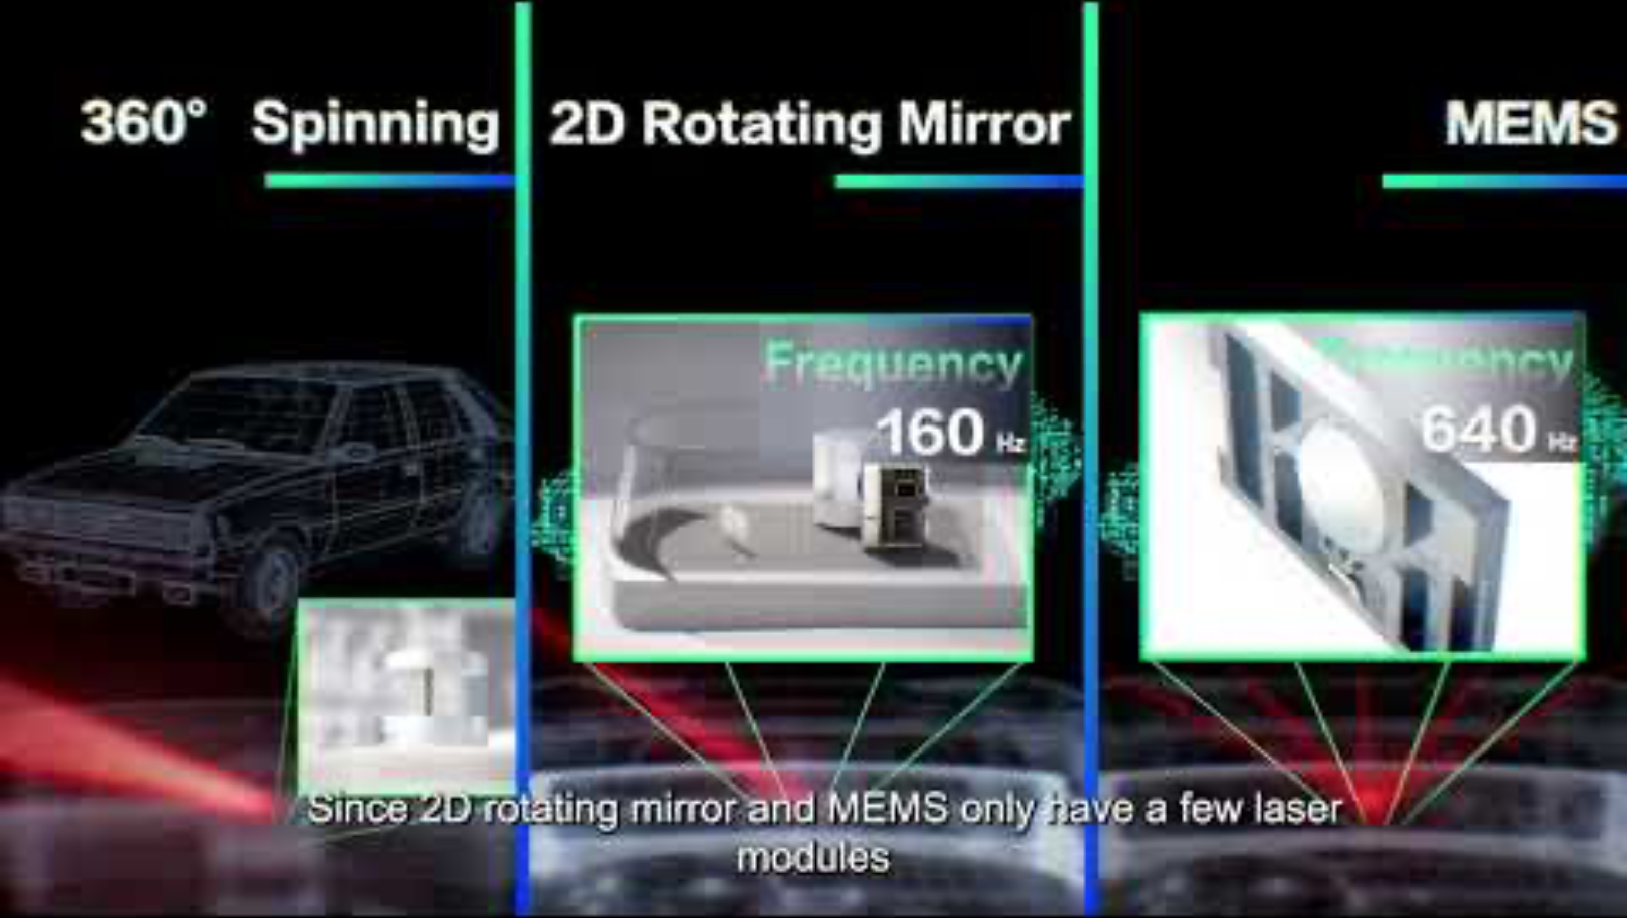
Sensors: Optical Time-of-Flight
3:15

Slide 12
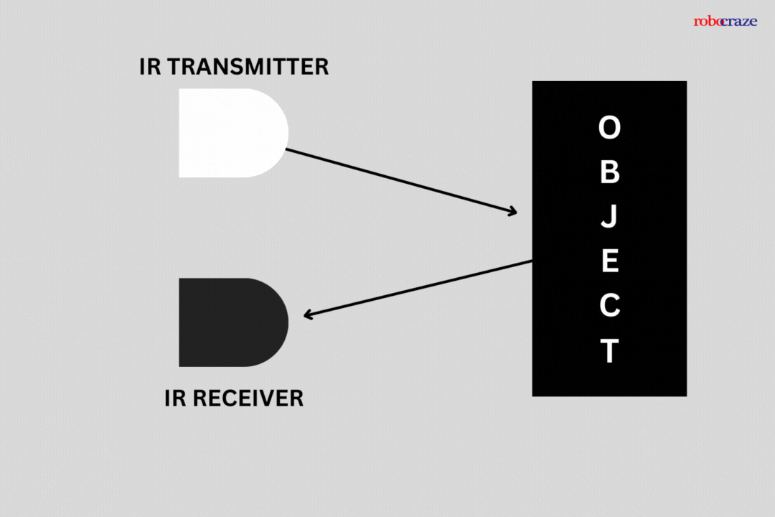
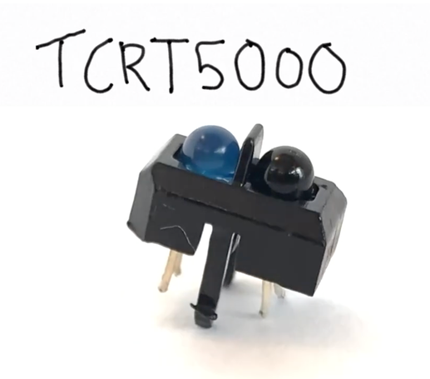
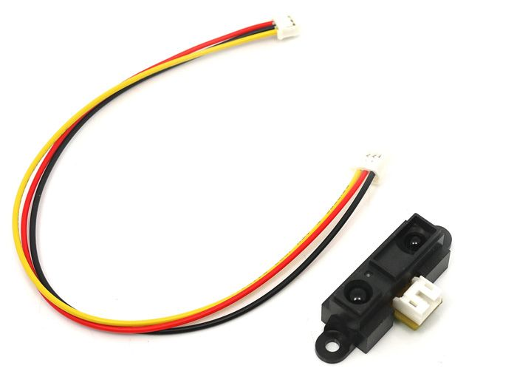
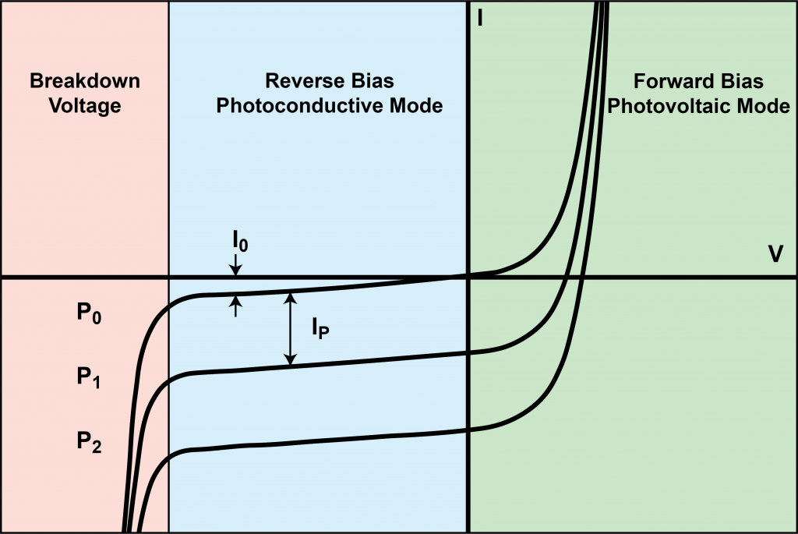
Sensors: Optical Non-ToF
Photodiode

Slide 13
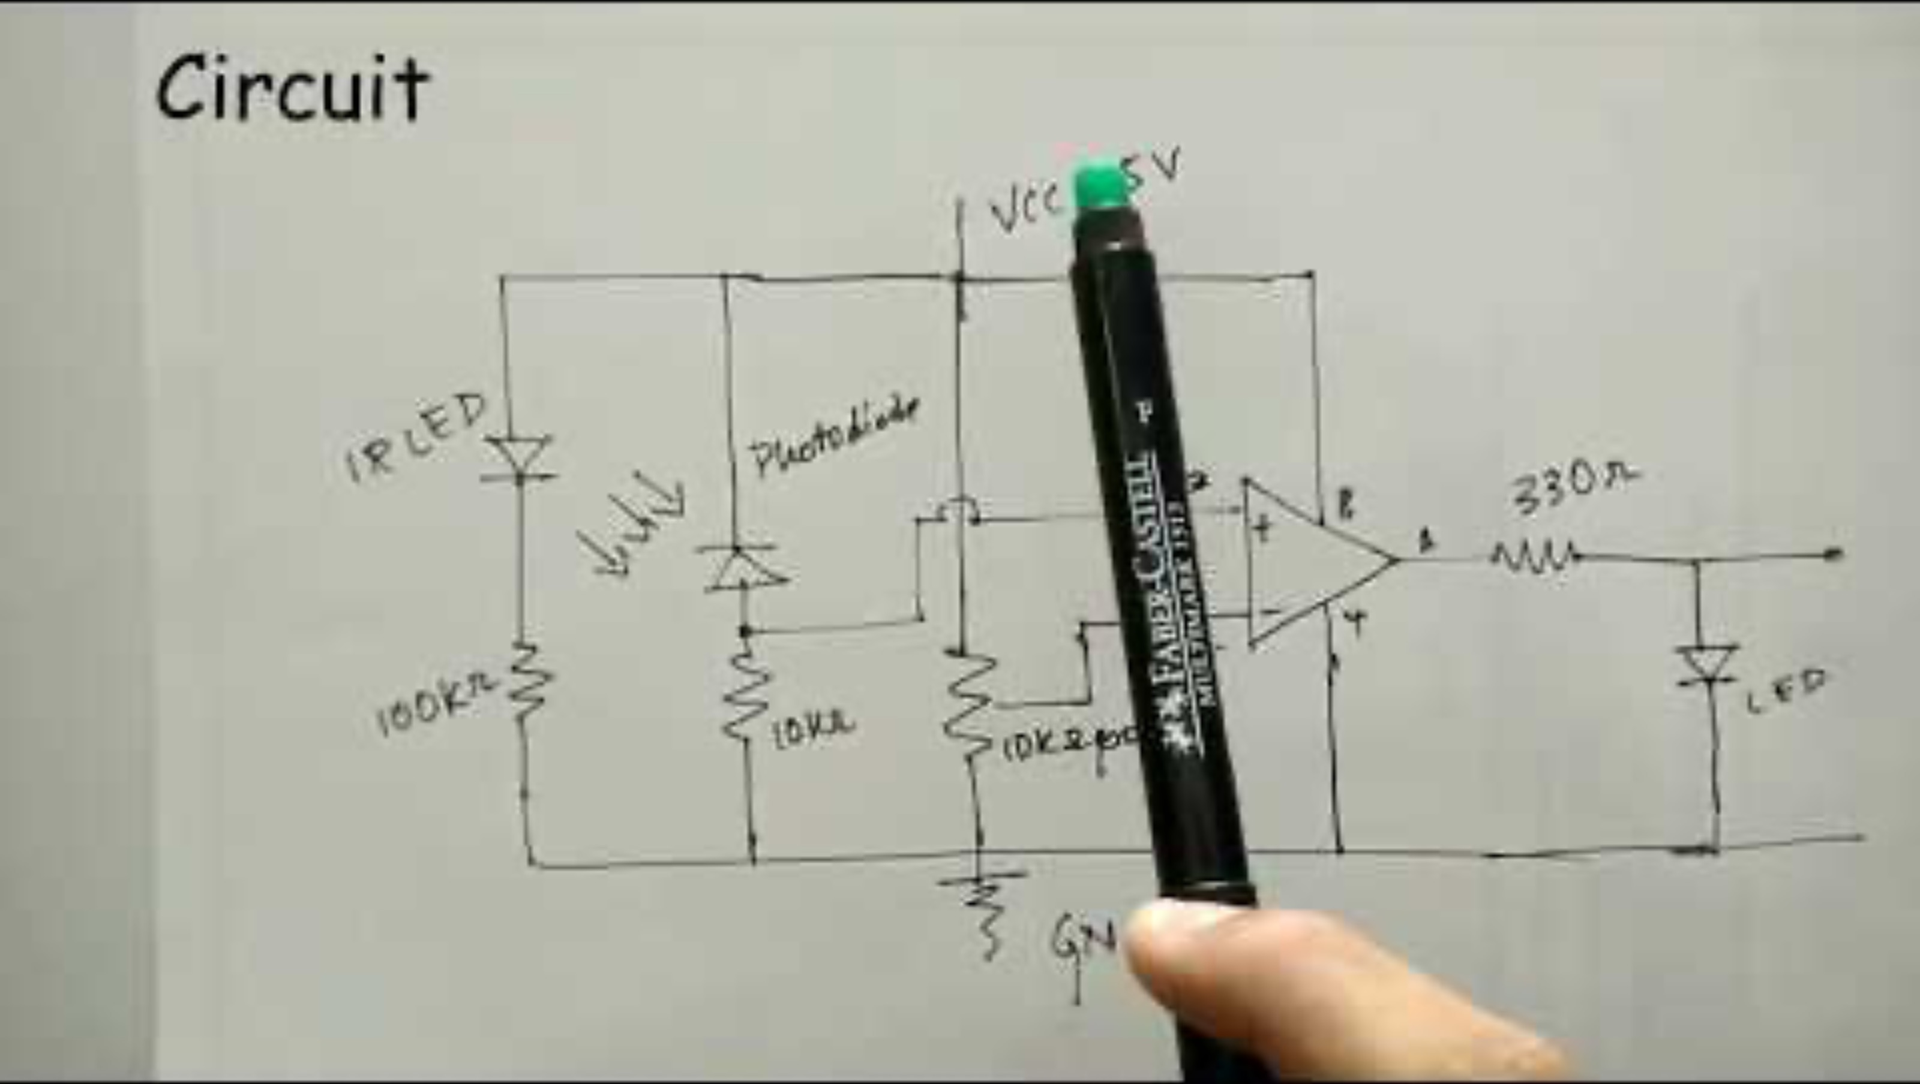
Sensors: Optical Non-ToF
3:00

Slide 14
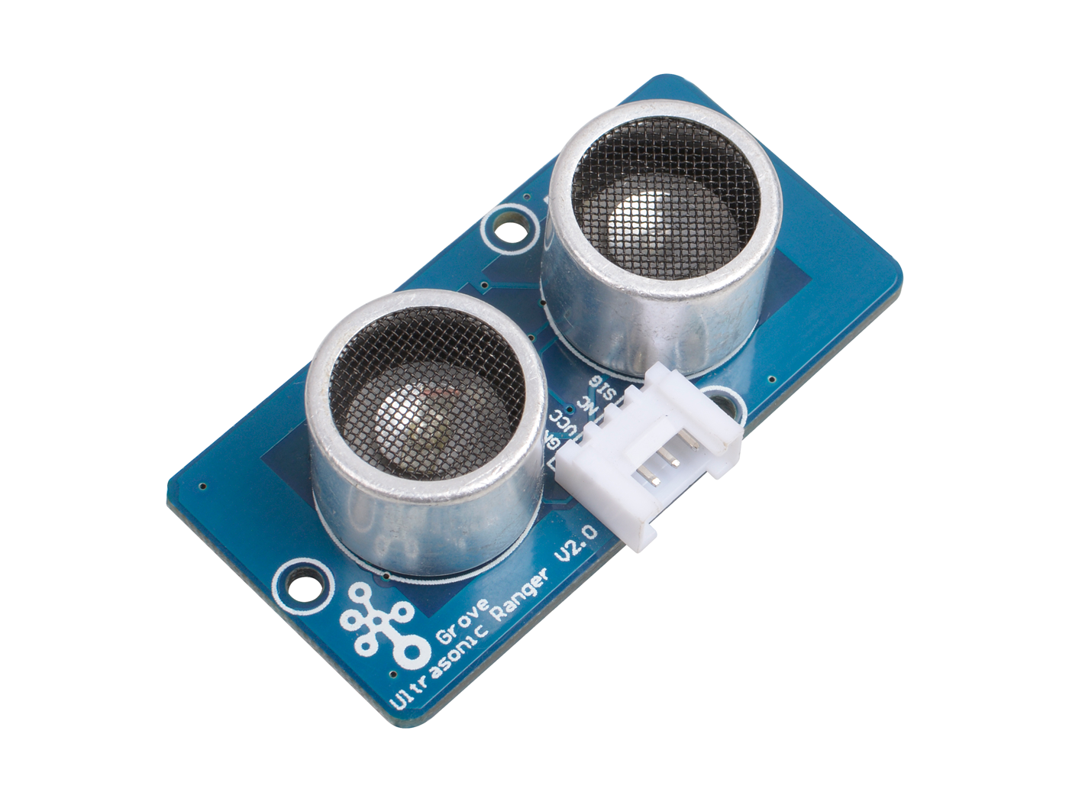
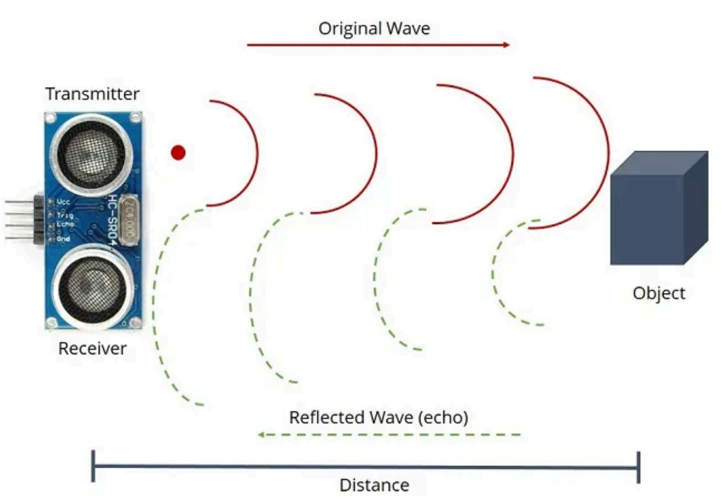
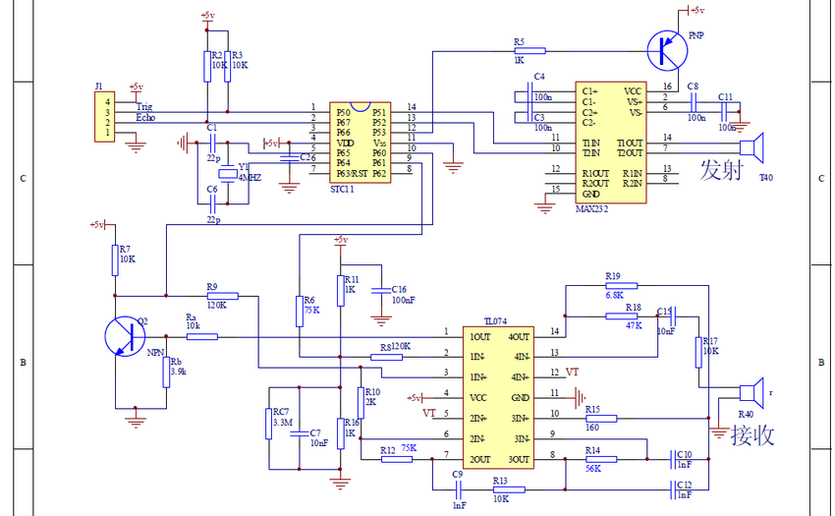
Sensors: Acoustic Time-of-Flight
HC-SR04 (common)

Slide 15
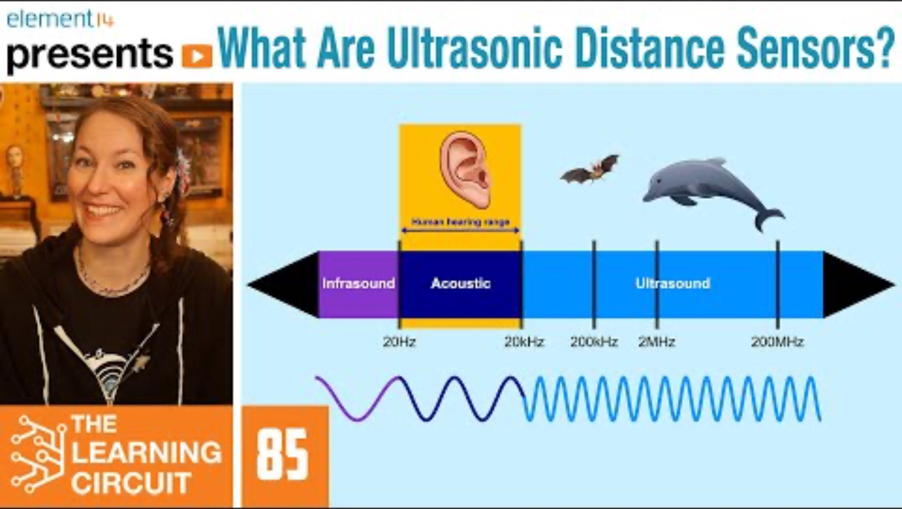
Sensors: Acoustic Time-of-Flight
4:20

Slide 16
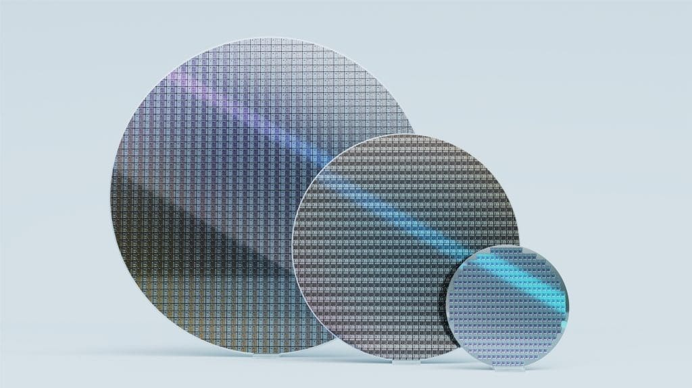
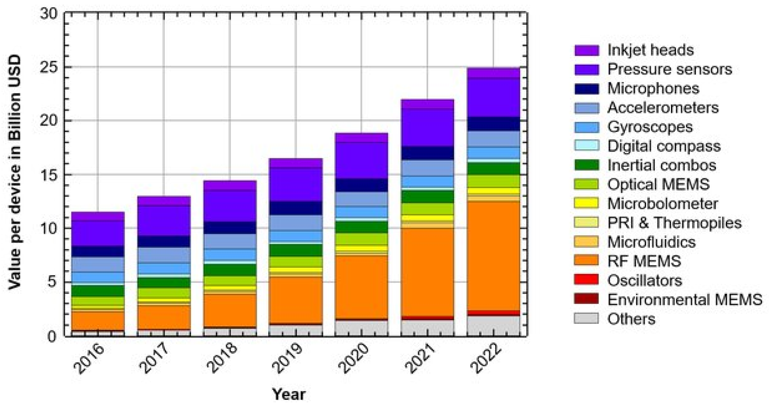
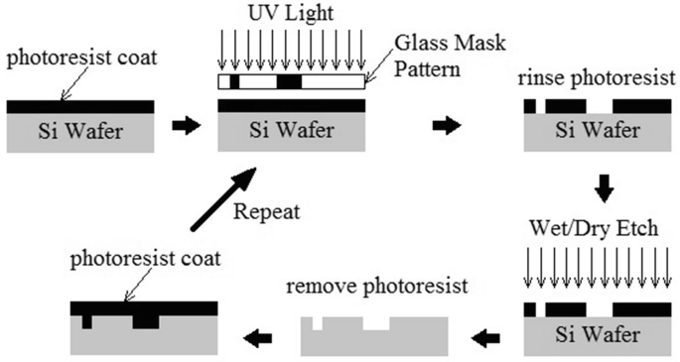
Interlude: Micro Electromechanical Systems (MEMS)

Slide 17
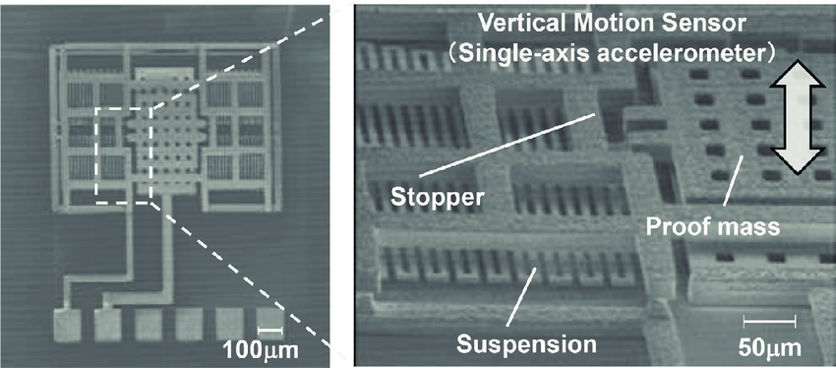
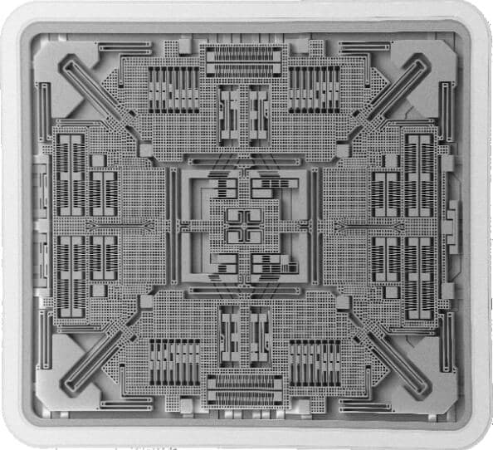
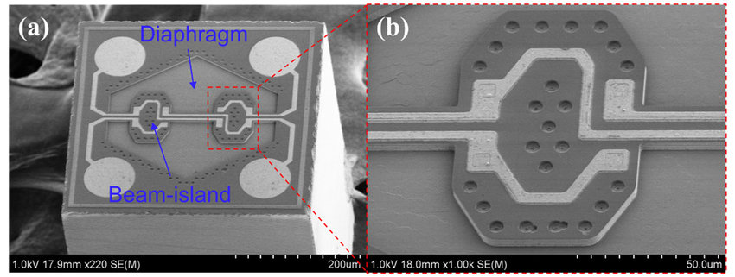
Interlude: Micro Electromechanical Systems (MEMS)

Slide 18

Interlude: Micro Electromechanical Systems (MEMS)
2:05

Slide 19
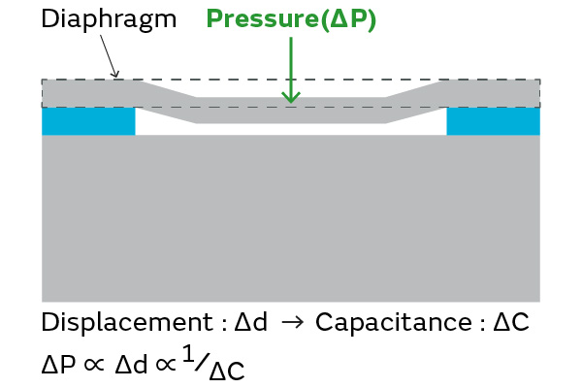
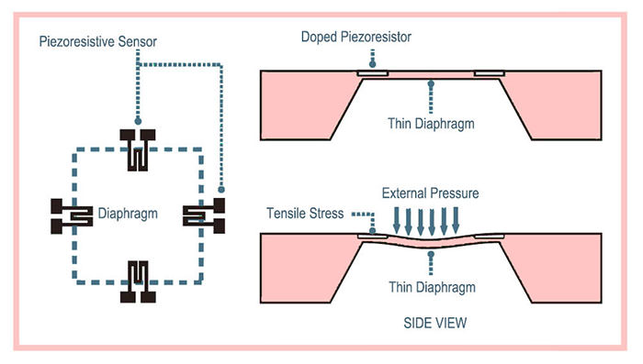
Sensors: Barometer / Altimeter
Piezoresistive Pressure Sensor
Capacitive Pressure Sensor

Slide 20
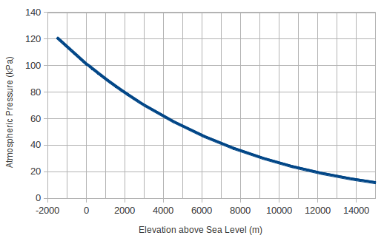
Sensors: Barometer / Altimeter
Piezoresistive Pressure Sensor
Barometer-based altimetry accurate to a few meters

Slide 21
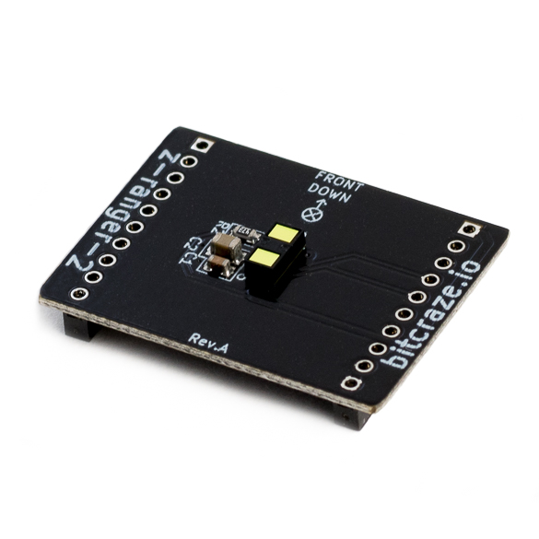
Sensors: Barometer / Altimeter
Piezoresistive Pressure Sensor
Barometer-based altimetry accurate to a few meters
Note: small altimeters are usually optical tof, not pressure;
they fly low enough to not need a barometer

Slide 22
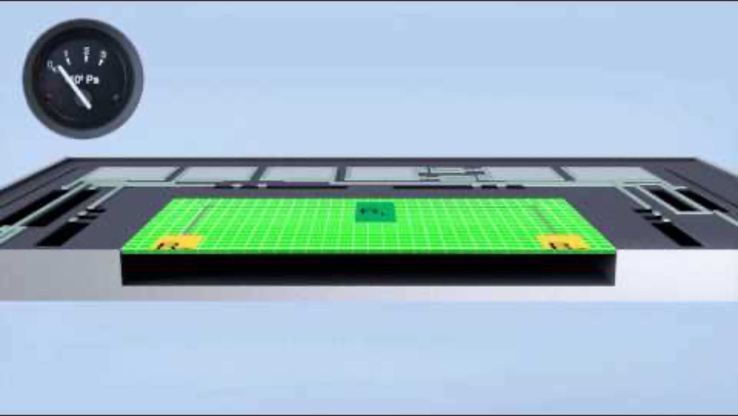
Sensors: Barometer / Altimeter

Slide 23
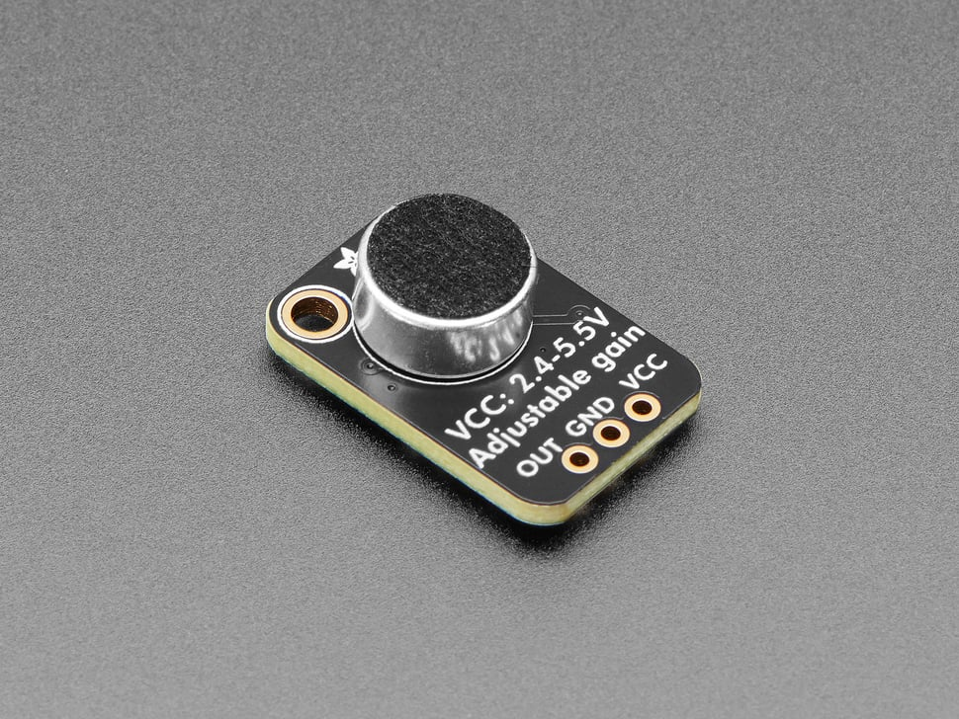
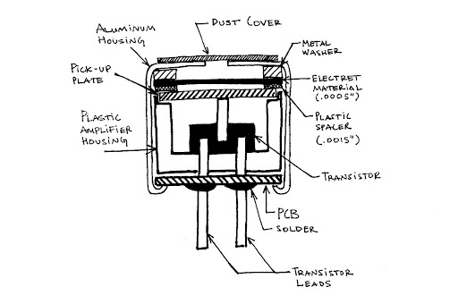
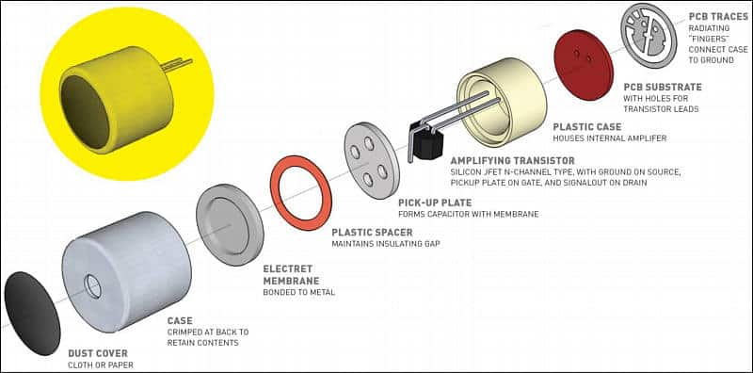
Sensors: Microphones
Electret microphone
Electret materials have a permanent static charge, so capacitor doesn’t need to be externally powered

Slide 24
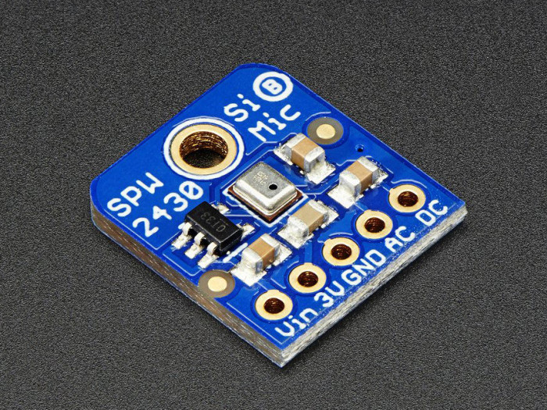
Sensors: Microphones

Slide 25


Sensors: Microphones
Inan et al., 2017
Common in mobile devices (e.g., smartphones)

Slide 26





Sensors: MEMS Inertial Measurement Unit
“6-axis IMU” = Accelerometer, gyroscope. “9-axis IMU” = Accel., gyro., magnetometer.
Accelerometer
Gyroscope
$$F=ma$$
$$F_{C}=−2m\left(Ω × v\right)$$

Slide 27


Sensors: MEMS Inertial Measurement Unit
“6-axis IMU” = Accelerometer, gyroscope. “9-axis IMU” = Accel., gyro., magnetometer.
Accelerometer
$$F=ma$$

Slide 28








Sensors: MEMS Inertial Measurement Unit
$F=ma=kx$
$$k_{beam}=\frac{12EI_{b}}{L^{3}}$$
$$I_{b}=\frac{tw^{3}}{12}$$
$$x∝ΔC$$
$$a=\frac{k}{m} x$$
$$C=\frac{ε_{0}A}{d}$$
$k_{tot}=k_{f1}+$ $k_{f2}$ $+ k_{f2}$ ${+ k}_{f2}$

Slide 29


Slide 30



Sensors: Cameras

Slide 31

Sensors: Cameras
2:05

Slide 32
Readout Circuitry

Slide 33
Analog-to-Digital Conversion

Slide 34
Noise and Error

Slide 35
Calibration

Slide 36
Basic Digital Signal Processing

Slide 37
Analog Signal Conditioning

Slide 38
Basic DSP cont.

Slide 39
Lecture (~45 minutes)
Subsystem check-in (~20 minutes)
Questions?
Questions?
Lecture 1: sensors → data acquisition
Lecture 2: signal processing → mapping

Slide 40

693H Robotic Subsystems
Motors, drive electronics, encoders, PID controllers, top-down tracking
Sensor suite (IMU, prox.), calibration code, general IO (buttons and LEDs)
Mobility
Perception
Compute and Power
Control and Planning
Battery and charging, wireless comms, GPIO and power distribution routing
microROS, ROS2, Gazebo simulation, enclosure design
Mechanics / Prototyping
Coding
PCB Design

